Slide 1

Engagement
Session
Agenda
(30min) Engagement Best Practice Panel & Q/A
(30min) Engagement Breakout Session
I like, I do, I wish, what if?
(20 min) Review
(15min) Break
(15min) Review BCES Rewards & Recognition Recommendation for Enterprise
(30 min) Rewards & Recognition Feedback Session (I like, I learned, I will)
I like, I do, I wish, what if?
(20 min) Review
Notes:
As you teach a lesson, you create a chart, together with your students, that captures the most important content and relevant strategies

Slide 2

Josette Lawrence
Engagement Best Practices
Meeting Strategies (Huddles, Team Meetings etc.) | Non-Meeting Strategies
I have different themes for different days of the week. I don’t always focus on stats (ex. Trivia Mondays, Ulysses Tuesdays, Thankful Thursdays etc) I allow agents to participate and lead huddles We conduct best practices roundtables during huddles. I also solicit feedback on how agents would like to be engaged Shout-outs, certificates, and recognition for agents at different levels of performance ( best performance or most improved) During one on ones, agents most come prepared to speak to their performance using the CSR toolbox | Team Lawrence Virtual Spirit Week (Demo): Week-long prep-rally with team in which huddles are converted into fun activities (Dancing, karaoke, movie clips, mis-match day, pj day) Very Engaged Team Chat – Utilize Praise Application within teams Daily Shout Outs to most improved as well as best performer of the day High performers are submitted to leaderboards on site. I also submit People Matter, I Matter compliments

Slide 3



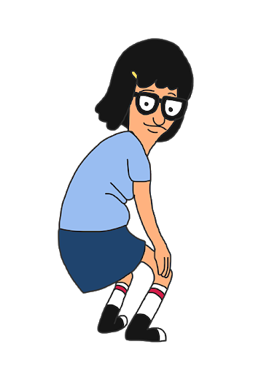

Team Spirit Week – Huddle Agenda (10min per Day)
Team Josette
Monday | Tuesday | Wednesday | Thursday | Friday
Health and Fitness | Movie Tuesday | Wacky Wednesday | Pajama & Coffee Day | Dance Party
Activities |  | Activities | Activities
2 Truths and a Lie |  | Would you rather | Trivia Game

Slide 4
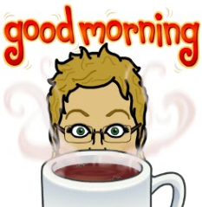
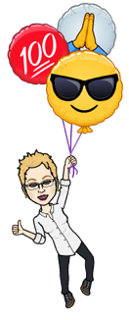

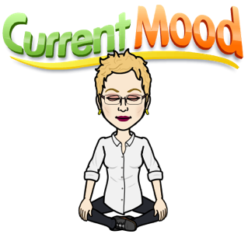

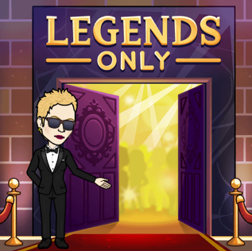

Sue Evans
Engagement Best Practices
Meeting Strategies (Huddles, Team Meetings etc.) | Non-Meeting Strategies
Included funny memes and Bitmoji’s Call Out Leaders (High-Performers, Rock Stars) Reinforce competitive environments (Demo: Ulysses Competition) Post-stats in daily huddle channel Perfect Call Spotlight: Acknowledging agents exceptional use of Ulysses strategies (Demo) | Individual recognition and greetings to agents every morning on MS Teams One huddle a week is dedicated to non work-related activity (Demo: Meditation via Calm app) 10min “Virtual Water Cooler”: Agents join meeting on gallery view to chat with one another Team Chat: Silly chat, memes

Slide 5
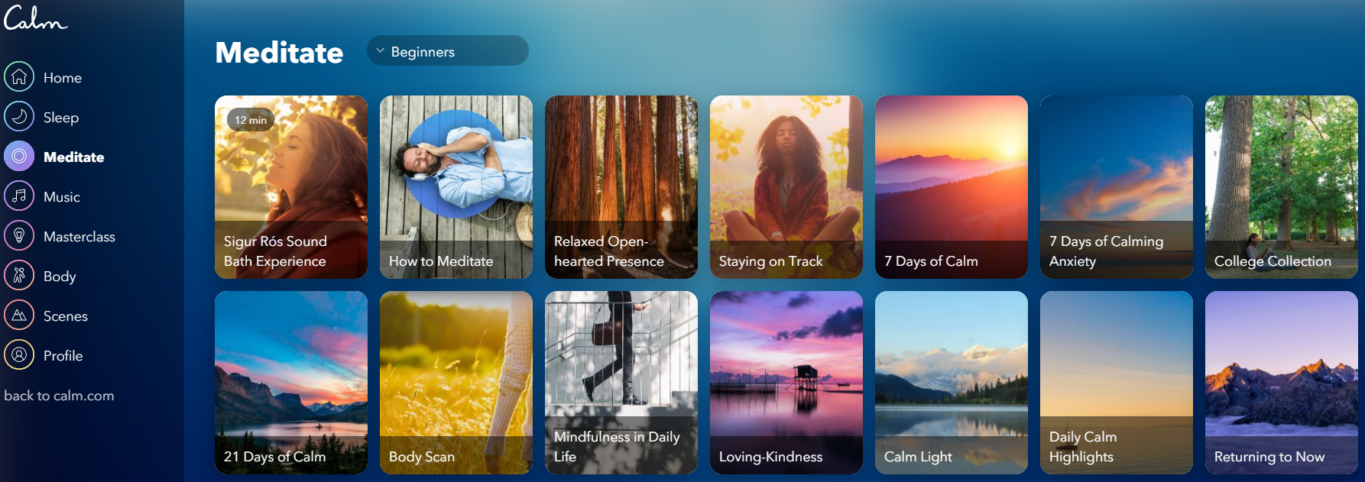
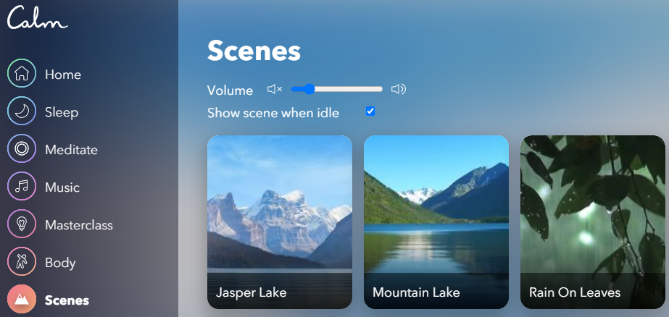

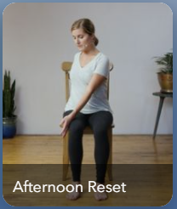

Slide 6
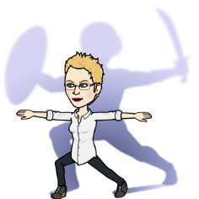
~Ulysses Competition~
Acknowledge
I can
Transition to Probing
Probing
Solutions with Options
Recap
Additional assistance
SPICES
Beginning TODAY, I will be listening for the “Acknowledge” step.
Tips: This step doesn’t only take place at the beginning of the call.
If the caller speaks to an emotion during the call, “acknowledge” it.
If they are new to KP, “welcome them”
Every time I hear you deliver the step we are focusing on, you get a point. I will listen to each person at least once a day. The person or persons with the most points at the end of business on Friday 11/20 will win a prize or prizes……
LET THE GAMES BEGIN!!
Blanca A
Suzie A
Sal A
Crystal A
Beverly A
Ana
Jessica A
Candace A
Cynthia L A
Dana A
Tayler
Teena A
Tamara A
Shirley A
Cynthia V
Ammie
Ari
Heidi A
Amina A

Slide 7
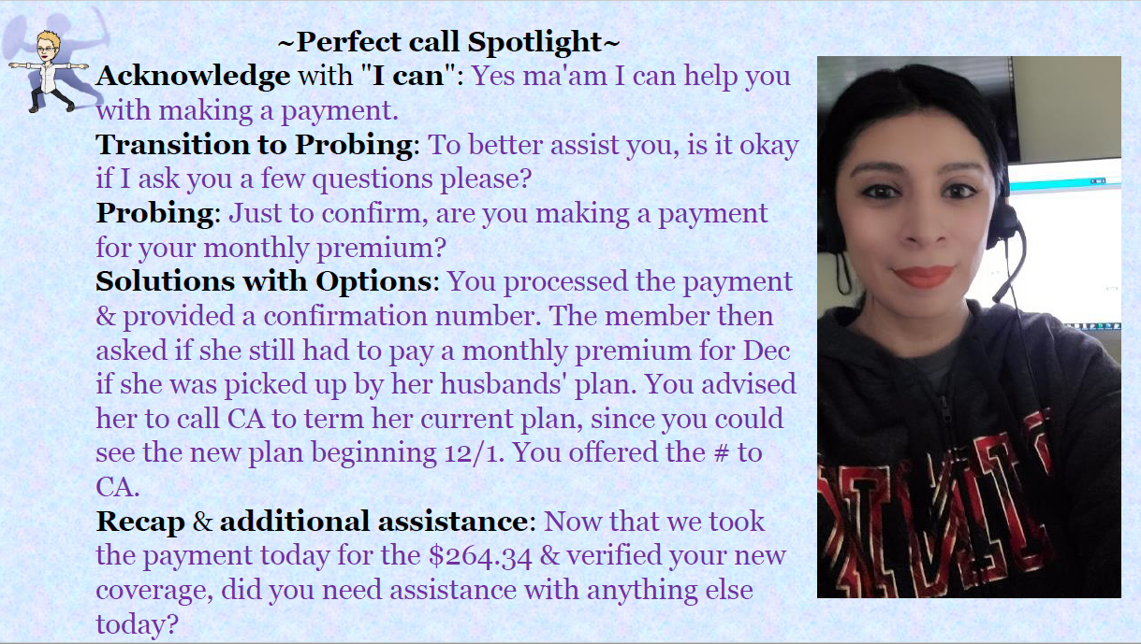

Slide 8
Terry Mcclenney
Engagement Best Practices
Meeting Strategies (Huddles, Team Meetings etc.) | Non-Meeting Strategies
I use Kahoot! (Demo) Role Play – Huge for my staff. Know your team, meet them where they are, and have fun Agents share their best practices with each other during huddles Sometimes I allow space for my agents to have their moment during huddles. Agents can share in a safe space | Break-off Huddle: Just to hang out with each other; open forum Very Engaged Team Chat – Utilize Praise Application within teams. We communicate constantly back and forth Daily Shout : KPI drive shout outs or kudos to staff I also submit People Matter, I Matter compliments; I send thank you notes for staff (via MS teams) I send inspirational thoughts and notes during the week (it doesn’t work for everyone, but it really works for my team) Random acts of appreciation throughout the day/week

Slide 9

Breakout Session
30 min
“I Like”: TMs are encouraged to convey the aspects that he or she liked about engagement practices shared by panelist
“I Do”: TMs are encouraged to share and document how they engage their agents today. What engagement strategies have been successful for you?
“What If”: TMs can share/brainstorm other ideas (new or recycled) aimed at engaging & motivating staff both. This opens possibilities for new ideas that your team can explore in future.
Notes:
Performance scorecards are often said to be a visual answer to the question, "How are we doing?“
Each KPI is typically displayed as a symbol indicating the health of that particular metric
Similar to a grade school report card, the scorecard measures periodic results (weekly, monthly, quarterly, annually) against a predetermined goal, allowing users to gauge how their performance stacks up against expectations.
We can start to drill down quickly on agents or TM, Oms that show patterns or trends of unfavorable performance (bottom 5 section)
When performance iss ues stand out on a top-level scorecard, it’s possible to “drill down” to layers of data that give further details. The bottom line is that scorecards encourage thorough monitoring and timely corrective actions.

Slide 10
15min Break
Be back @
Notes:
As you teach a lesson, you create a chart, together with your students, that captures the most important content and relevant strategies

Slide 11



During a global pandemic, social-political unrest, while working from home engagement is critical
Opportunity Statement
Improving Employee Engagement Worldwide
“Just 13 percent of employees worldwide are engaged in their jobs, a recent Gallup report found -- meaning that they're "involved in, enthusiastic about and committed to their work and workplace."
What about the rest? Not so much….
There is a desire among managers to motivate, recognize, and reward frontline in an engaging and fun way
Notes:
Over the last few months, glayds lars and Chelsea have spent a lot a time working with ops to improve performance management across TM and OM at the MSCC. We traveled site to site, leaning about each site practices, culture, pain points, and performance gaps. IN our work we quick witnessed the variation of who site rexocngized and rewared their agents. The most glaring example was regarding2 agents that had med Every single metric in 2019, taking thousands of calls, provide the best service and at the end of it all getting a pat on the back and a gift card. I was in shock! That was it? And I also thought to myself what does her engagement look like? And what about the other thousands of CSRs across the enterprise. So I set on a journey to learn more about way organizations engaged their employees in environments similar to our own. And what I ended finding were some interesting stat.
For instane organizations with strong engement show
147% better performance compared to others.
25-65% less turnover.
37% fewer absences

Slide 12

147%
25-65%
37%
Better Performance Compared to Organizations in the Poll
Less Turnover
Fewer Absences
Notes:
For instane organizations with strong engement show
Gallup report that
147% better performance compared to others.
25-65% less turnover.
37% fewer absences
Now outside the context of KP, “Just 13 percent of employees worldwide are engaged in their jobs, a recent Gallup report found -- meaning that they're "involved in, enthusiastic about and committed to their work and workplace.“
It’s a sad story for the remaining 87%. Add to the fact we are the midst of a pandemic for many of us to work from home.
Now more than ever managers are eager to find new and creative ways to engage their staff. We spoke about nearpod for example.
As a result, Our team has been working on developing a standardized framework for rewards and recognition. And similar to the scorecard development, each site has had an opportunity to mold this framework, to add to, and provide their feedback. Now Denver will have an opportunity to do the same!
As a result, Our team has been working on developing a standardized framework for rewards and recognition. And similar to the scorecard development, each site has had an opportunity to mold this framework, to add to, and provide their feedback. Now Denver will have an opportunity to do the same!

Slide 13
Reward &
Recognition
The Approach…..
Notes:
As you teach a lesson, you create a chart, together with your students, that captures the most important content and relevant strategies

Slide 14

Rewards & Recognition Program Ideation Recap
Brainstorm Ideas
Brainstorming Session w/ Site Management
What are fun rewards and recognition theme our site might be interested in?
Notes:
OMs and TMs brainstormed recognition rewards that agents, TMs and Agents could receive if key performance indicators were achieved.
We heard it all, the idea was to have fun and be creative and to some extent extravagant.
Ideas ranged from displaying balloons on site to trips to Disneyland.

Slide 15
Rewards & Recognition Program Ideation Recap
Priority Matrix for Award Ideas
CSRs
9.1 | Wall of Fame / Town Hall Rec.
8.5 | Monthly KP Bucks
7.9 | Priority Parking Spot
7.8 | Time Extras (Breaks, lunch's, early off)
7.8 | Gift Cards
6.6 | Amazon List
6 | Event Tickets
6 | Wow Call Recognition
6 | Engagement w/ Mgmt Team
5.4 | 100% Email to site and add balloons
4.2 | Traveling Trophy
TMs
11.5 | Flex/Day Off/Early Outs etc
10.7 | Spot Bonus
8.4 | Professional Development
8.4 | WFH Rewards
8.4 | Parking Spots
6.9 | Milestone Awards – Birthdays etc
6.9 | Recognition for Most Improved
6.9 | Big Ticket Item (Vacation, Cash, Gift Card)
6.1 | Break room
5.3 | Wall of fame / Certificate / Plaques
5.3 | Quarterly Treat Celebration
Brainstorm Ideas
Brainstorming Session w/ Duluth Management
OMs and TMs brainstormed recognition rewards that agents, TMs and OMs could receive if key performance indicators were achieved. Ideas ranged from displaying balloons on site to trips to Disneyland.
Prioritize Awards
Prioritized Awards by Interest
What do we value the most? What do we think out agents value the most?
Top Performers ?
Hitting Metrics?
Experience Measures?
Notes:
TMs ranked and prioritized awards based on perceived motivations, wants, and goals of front-line staff.

Slide 16
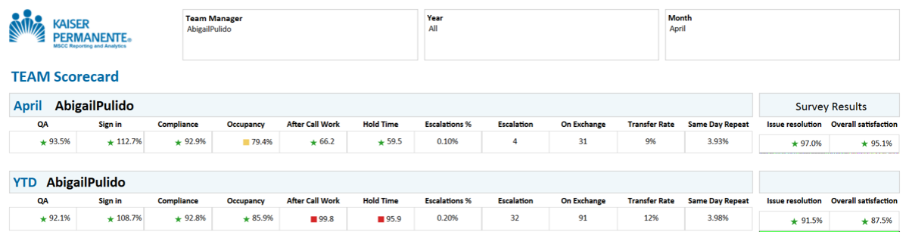
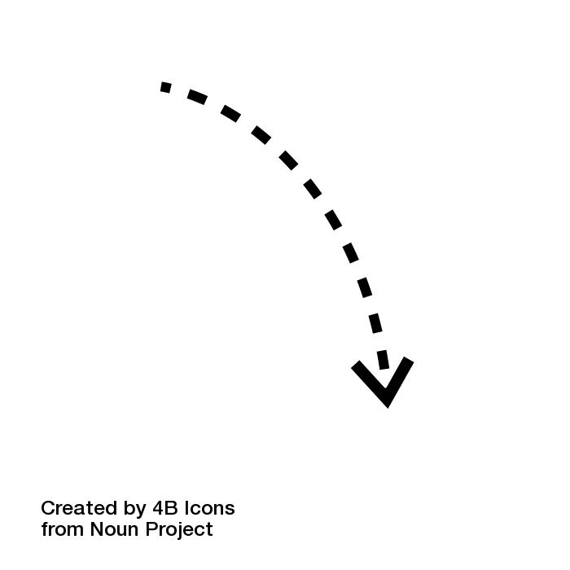
Rewards & Recognition Program Ideation
Performance Scorecard & Awards
Brainstorm Ideas
Brainstorming Session w/ Duluth Management
OMs and TMs brainstormed recognition rewards that agents, TMs and OMs could receive if key performance indicators were achieved. Ideas ranged from displaying balloons on site to trips to Disneyland.
Prioritize Awards
Prioritized Awards by Interest
TMs ranked and prioritized awards based on perceived motivations, wants, and goals of front line staff.
Gift Cards?
Performance Goals
Align Awards to Performance Goals
Next, let’s align performance goals, as measured by our scorecard, with awards YOU brainstormed during our last session. After this session any remaining activities will continue through your Rewards & Recognition Committee.
Parking Spots?
Extend Lunch?
Vacation?
Event Tickets?
Spot Bonus?

Slide 17
Rewards & Recognition Program Suggestion
Award Theme
Most Valuable CSR
Outstanding CSR
Most Valuable Team (TM)
CRS of the Year
TM of the Year
Performance Indicators Bundle
QA Escalations Same Day Customer Satisfaction
After Call Work Hold Time Sign-In / Compliance
Overall Team Performance
Member Experience & Outstanding Metrics
Member Experience & Outstanding Metrics
Achievement Criteria
Achieved at least 5 out of 5 targets by month-end
Achieved at least 4 out of 4 targets by month end
Different performance competitions each Quarter
Year End MVP/Outstanding status
Year End MVP/Outstanding status
Rewards Bundle
WOW Call Recognition
Parking Spot (CSR)
KP Bucks / KP Swag
Time Extras ( ex. Extended Lunch)
Event Tickets / Gift Card / Amazon
Town Hall Shout Out
Time Extras (ex. Extended break)
100% Email to site + add balloons
Parking Spots (TM)
Time Extras/WFH (TM)
Team Trophy
Potluck/ Luncheon with OM/ED
Disneyworld / Contact Center Visit / Lunch w/ Jody / Wall of Fame
Disney / Professional Development Retreat / Contact Center Visit
Spot Bonus
TM plaque/Pin
Frequency
Monthly
Monthly
Quarterly
Year End
Year End
# CSR Awarded per
All CSRs
All CSRs
1 Team for Site
All CSRs
All TMs

Slide 18
Breakout Session
30-45 min
“I Like”: TMs are encouraged to convey the aspects that he or she liked about the framework we built in Duluth and Fulton.
“I Do”: TMs are encouraged to document how they reward and recognize their agents today. Or how TMs are rewarded and recognized.
“I Wish”: TMs are prompted to share ideas of how the framework used in Duluth/Fulton can be changed or improved so as to address gaps they see or needs in Denver.
“What If”: TMs can express new suggestions that might not have a direct link to the framework...it could be completely different in fact. This opens up possibilities for new ideas that your team can then explore in future.
Notes:
Performance scorecards are often said to be a visual answer to the question, "How are we doing?“
Each KPI is typically displayed as a symbol indicating the health of that particular metric
Similar to a grade school report card, the scorecard measures periodic results (weekly, monthly, quarterly, annually) against a predetermined goal, allowing users to gauge how their performance stacks up against expectations.
We can start to drill down quickly on agents or TM, Oms that show patterns or trends of unfavorable performance (bottom 5 section)
When performance iss ues stand out on a top-level scorecard, it’s possible to “drill down” to layers of data that give further details. The bottom line is that scorecards encourage thorough monitoring and timely corrective actions.

Slide 19
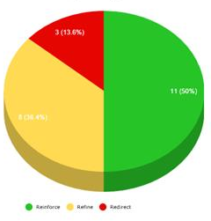
Reward &
Recognition
Team Review (15min)

